Slide 1
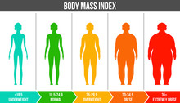
BMI Calculator Project.

Slide 2
What is the BMI? The Body Mass Index (BMI) is a measure that uses your height and weight to check if your weight is healthy. The BMI calculation divides an adult's weight in kilograms by their height in metres squared.

Slide 3
Aim.
What is the aim of calculating BMI?
To create a reliable indicator making use of a patient data such as weight and height to determine categories that could lead to health problems like Obesity and Heart failures.

Slide 4
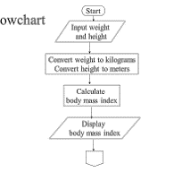




Slide 5
ThanK You!

